Slide 1
React/ReactJS/React.js
Module: 4: Fundamentals of React.js [Lecture-9Hrs] [Application]
Overview of React.js.; Reactive Programming; React Components; Render Method; Virtual DOM and Bandwidth Salvation; Two Distinct Ways of Initializing a React Class; States & Life Cycles; Component Mounting; Node.js & NPM; JSX Walkthrough; React Testing

Slide 2
Overview of React.js

Slide 3
Industry Trends for React/React.js
React developers earn more money when compared to other web development technologies.
Average salary of React developer across the US is $91,000 per annum.
Average salary of React developer across in India is 7,25,000 per annum.
React is gaining popularity and being adopted by many countries.
:

Slide 4
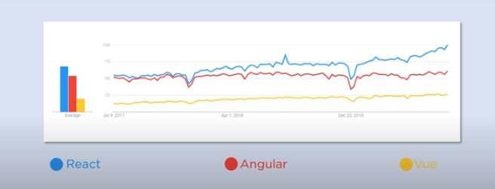
Data by Google Trends for Web development framework

Slide 5


Companies using react:

Slide 6
React Pre-requisites
One should be familiar with programing concepts like function, arrays, Objects and classes.
HTML
CSS
JavaScript
Understanding of ES6 (ES6 stands for ECMAScript 6. ECMAScript was created to standardize JavaScript, and ES6 is the 6th version of ECMAScript )

Slide 7
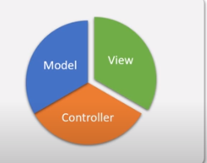

React/React.js/ReactJS
React (also known as React.js or ReactJS) is a free open source java script library for building fast an interactive front end UI interfaces for web and mobile applications.
It is used for building user interfaces specifically for single-page applications which means complete website in single page
In MVC architecture, react is the view which defines how the app looks and feels like.
It’s used for handling the view layer for web and mobile apps. React also allows us to create reusable UI components.
React is a User Interface (UI) library
React can be used to develop both web and mobile interfaces.
It was developed in facebook now meta in 2011.
React was developed by “Jordon Walke” an engineer in facebook.
It is maintained by the community of individual developers.
React first deployed on Facebook’s newsfeed in 2011 and on Instagram.com in 2012.
Notes:
MVC (Model-View-Controller) is a pattern in software design commonly used to implement user interfaces, data, and controlling logic. It emphasizes a separation between the software's business logic and display

Slide 8
React allows developers to create large web applications that can change data, without reloading the page.
The main purpose of React is to be fast, scalable, and simple.
It works only on user interfaces in the application.
This corresponds to the view in the MVC template.
It can be used with a combination of other JavaScript libraries or frameworks, such as Angular JS in MVC.

Slide 9
To conclude : we can say…..
React is a declarative, efficient, and flexible JavaScript library for building user interfaces. It lets you compose complex UIs from small and isolated pieces of code called “components”. React has a few different kinds of components.

Slide 10
Why React is so popular
Easy creation of dynamic web site.
Performance enhancement
Reusable components
Unidirectional Data flow
Small Learning Curve
Can be used for mobile apps
Dedicated tools for debugging

Slide 11
React Compiler: Babel
Babel is a JavaScript compiler that can translate markup or programming languages into JavaScript.
With Babel, you can use the newest features of JavaScript (ES6 - ECMAScript 2015).
Babel is available for different conversions. React uses Babel to convert JSX into JavaScript.
Please note that <script type="text/babel"> is needed for using Babel.

Slide 12


Slide 13

React Features:
Currently, ReactJS gaining quick popularity as the best JavaScript framework among web developers. It is playing an essential role in the front-end ecosystem. The important features of ReactJS are as following.
JSX
Components
One-way Data Binding
Virtual DOM
Simplicity
Performance

Slide 14

Features of React : JSX
JSX stands for JavaScript XML. It is a JavaScript syntax extension. Its an XML or HTML like syntax used by ReactJS.
In React, instead of using regular JavaScript for templating, it uses JSX.
JSX is a simple JavaScript that allows HTML quoting and uses these HTML tag syntax to render subcomponents.
HTML syntax is processed into JavaScript calls of React Framework.
We can also write in pure old JavaScript.

Slide 15
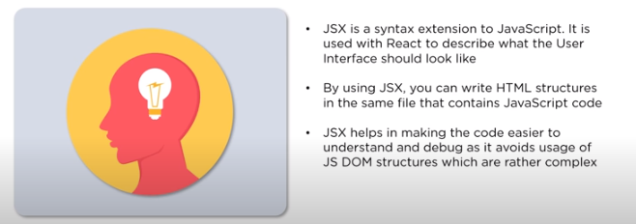


Slide 16

Java script Features: React Native
React has native libraries that were announced by Facebook in 2015, which provides the react architecture to native applications like IOS, Android and UPD.
React-native is a mobile apps building framework using only Javascript.
It uses the same design as React, letting you utilize/include a rich mobile UI library/ declarative components. It uses the same fundamental UI building blocks as regular iOS and Android apps. The best part of using react-native is to allow/adopt components written in Objective-C, Java, or Swift.

Slide 17
One-way Data Binding/ flow
ReactJS is designed in such a manner that follows unidirectional data flow or one-way data binding.
The benefits of one-way data binding give you better control throughout the application.
If the data flow is in another direction, then it requires additional features.
It is because components are supposed to be immutable and the data within them cannot be changed.
Flux is a pattern that helps to keep your data unidirectional.
This makes the application more flexible that leads to increase efficiency.
In React, a set of immutable values are passed to the components renderer as properties in its HTML tags. The component cannot directly modify any properties but can pass a call back function with the help of which we can do modifications. This complete process is known as “properties flow down; actions flow up”.

Slide 18
Reactive Programming

Slide 19
Reactive Programming
Reactive programming utilizes asynchronous data streams. Typical events are asynchronous that we can watch or add extra effects.
When we create reactive programming, we’re creating data streams from events that happen as a result of variables, data structures, and just about anything.
Example: Google Maps app
It does this by tracking your location, the acceleration of your device, and its position relative to North. Then, it combines those values and submits them to the API every few seconds. The API then returns a response to the UI Thread which then displays it to you, the user, as a little moving dot on a map. That’s reactive programming in a nutshell.
Notes:
Google Maps appthe grocery store, the dot marking your location wou, for instance. The app places a dot on your relative location and when you move, the dot moves with you. For example, if you had the app open while walking from your house to ld move with you in real time.

Slide 20
To use React, developers typically use a combination of JavaScript, JSX (an extension to JavaScript), and CSS to define the UI components and their behavior.
Here is an example of a simple React component that renders a button:
import React from 'react';
function Button(props) {
return (
<button onClick={props.onClick}>
{props.label}
</button>
);
}
export default Button;

Slide 21
React Components
ReactJS is all about components. ReactJS application is made up of multiple components, and each component has its own logic and controls. These components can be reusable which help you to maintain the code when working on larger scale projects.

Slide 22
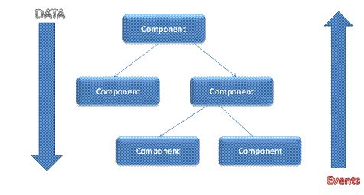

Slide 23
React Components
what are components in react js?
In ReactJS, a component is a reusable and independent piece of code that defines a part of a user interface. It can be thought of as a building block for constructing a larger application.
There are two main types of components in ReactJS:
Function Components: These are simple and stateless components that take in props (short for properties) as input and return a React element (JSX) as output. They are mainly used for rendering static content.
Class Components: These are more complex and can have state and lifecycle methods. They extend the React Component class and have a render() method that returns a React element. They are used for more complex logic and interaction with the user.
In addition to these main types of components, React also has a third type of component known as Higher Order Components (HOCs) which are functions that take in a component as input and return a new component with additional functionality.
Overall, components are the building blocks of a ReactJS application and are used to create reusable UI elements

Slide 24
Example 1
Class Components | Function Components
The class component also requires a render() method, this method returns HTML. class Car extends React.Component { render() { return <h2>Hi, I am a Car!</h2>; } } | Create a Function component called Car function Car() { return <h2>Hi, I am a Car!</h2>;}

Slide 25
Example 2
Now your React application has a component called Car, which returns an <h2> element.
To use this component in your application, use similar syntax as normal HTML: <Car />
import React from 'react';
import ReactDOM from 'react-dom/client';
function Car()
{ return <h2>Hi, I am a Car!</h2>;}
const root = ReactDOM.createRoot(document.getElementById('root'));
root.render(<Car color="red"/>);
output: Hi, I am a Car!

Slide 26
Multiple Components
Components can be reusable which help you to maintain the code when working on larger scale projects.
Example 3
import React from 'react';
import ReactDOM from 'react-dom/client';
function Car() { return <h2>I am a Car!</h2>;}
function Garage() { return ( <><h1>Who lives in my Garage?</h1>
<Car /> </> );}
const root = ReactDOM.createRoot(document.getElementById('root'));
root.render(<Garage />);
output:
Who lives in my Garage?
I am a Car!

Slide 27
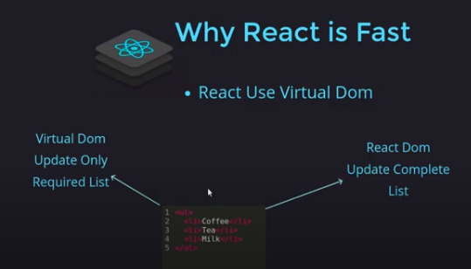
Why React is fast ?

Slide 28
Render Method

Slide 29
what is meant by rendering in react js?
Rendering in ReactJS refers to the process of displaying or updating the contents of the user interface based on the current state and props of the components.
When a React component is rendered, it generates a virtual DOM (Document Object Model) which is a lightweight representation of the actual DOM. The virtual DOM is then compared to the previous version of the virtual DOM, and only the differences are updated in the actual DOM. This process is called "reconciliation" and is done in an efficient manner to minimize the number of updates required to the DOM.

Slide 30
Example 4
The render() method is a required method in a React component. It is responsible for rendering the component's UI based on its current state and props.
In this example, the Greeting component takes in two props, name and day, and renders an HTML h1 and p element containing the values of those props.
The render() method returns a JSX expression that defines the component's UI. It can contain HTML elements, other React components, and JavaScript expressions.
Note that the render() method should be a pure function, meaning it should not modify the component's state or props. It should only return a new UI based on the current state and props. Any updates to the state or props should be handled by other methods in the component, such as setState() or event handlers.
Here is an example of a simple React component with a render() method:
import React from 'react';
class Greeting extends React.Component {
render() {
return (
<div>
<h1>Hello, {this.props.name}!</h1>
<p>Today is {this.props.day}.</p>
</div>
);
}
}
export default Greeting;

Slide 31
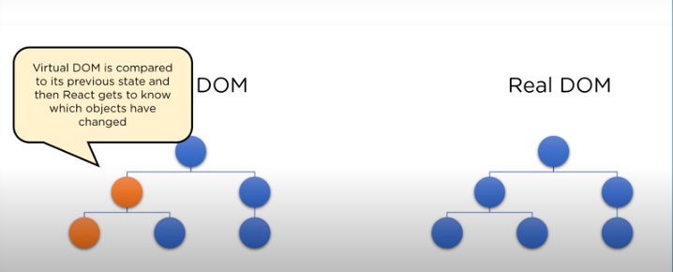
Virtual DOM

Slide 32
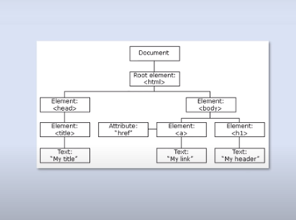
DOM(Document Object Model)
DOM treats an XML or HTML document as a tree structure in which each node is an object representing a part of the document

Slide 33
Virtual DOM
The virtual DOM (VDOM) is a programming concept where an ideal, or “virtual”, representation of a UI is kept in memory and synced with the “real” DOM by a library such as ReactDOM. This process is called reconciliation.
A virtual DOM object is a representation of the original DOM object. It works like a one-way data binding. Whenever any modifications happen in the web application, the entire UI is re-rendered in virtual DOM representation.
Then it checks the difference between the previous DOM representation and new DOM. Once it has done, the real DOM will update only the things that have actually changed.
This makes the application faster, and there is no wastage of memory.
React creates an in-memory data structure cache which computes the changes made
and then updates the browser. This allows a special feature that enables the programmer to code as if the whole page is rendered on each change whereas react library only renders components that actually change.

Slide 34
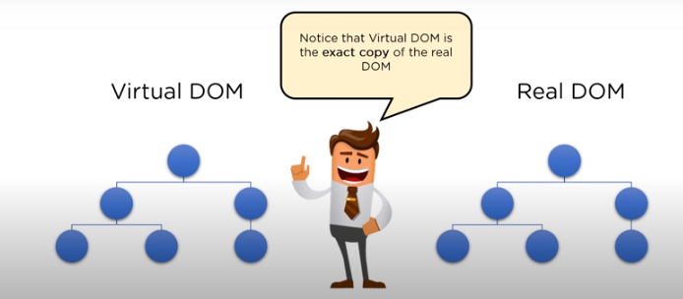
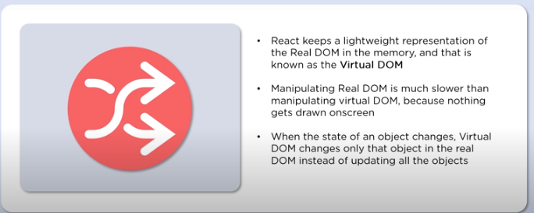

Slide 35
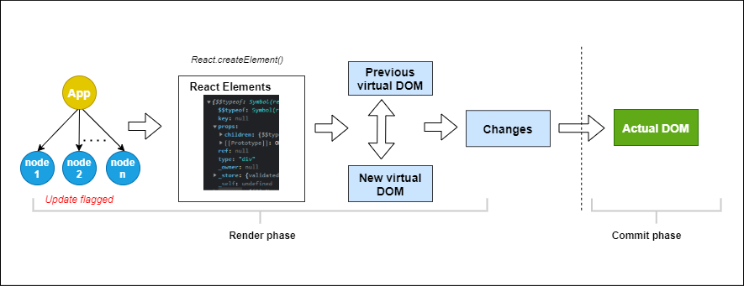
Below is a visual description of the rendering process when an application re-renders.

Slide 36
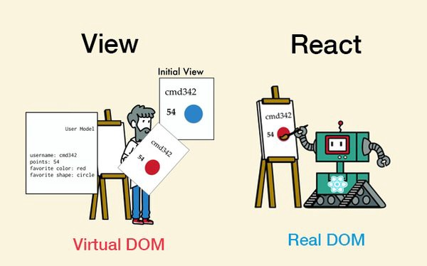

Slide 37
Bandwidth Salvation
Virtual DOM and Bandwidth Salvation are related concepts in ReactJS, but they are not the same thing.
The Virtual DOM is a concept in ReactJS that refers to a lightweight representation of the actual DOM (Document Object Model). The Virtual DOM is a JavaScript object that contains all the elements and attributes of the actual DOM, but it is faster and more efficient to manipulate than the actual DOM. When a component in ReactJS is updated, the Virtual DOM is used to compare the new state of the component with the previous state and determine the minimum number of changes needed to update the actual DOM.
Bandwidth Salvation(recovery/rescue), on the other hand, is a term used to describe the way ReactJS can reduce the amount of data that needs to be transferred over the network. Because the Virtual DOM is so efficient, ReactJS can minimize the amount of data that needs to be transferred over the network by only sending the changes that are needed to update the UI, rather than sending the entire UI every time there is a change.

Slide 38
Bandwidth Salvation
So, while the Virtual DOM and Bandwidth Salvation are related concepts in ReactJS, they are not the same thing. The Virtual DOM is a technology that enables ReactJS to efficiently update the UI, while Bandwidth Salvation is a benefit of using ReactJS that reduces the amount of data that needs to be transferred over the network, resulting in faster and more efficient web applications.

Slide 39
Simplicity
ReactJS uses JSX file which makes the application simple and to code as well as understand. We know that ReactJS is a component-based approach which makes the code reusable as your need. This makes it simple to use and learn.
Performance
ReactJS is known to be a great performer. This feature makes it much better than other frameworks out there today. The reason behind this is that it manages a virtual DOM. The DOM is a cross-platform and programming API which deals with HTML, XML or XHTML. The DOM exists entirely in memory. Due to this, when we create a component, we did not write directly to the DOM. Instead, we are writing virtual components that will turn into the DOM leading to smoother and faster performance.

Slide 40
strategies to reduce the bandwidth usage of ReactJS applications:
Code splitting: Code splitting divides the application code into smaller chunks that can be loaded on-demand. This technique can reduce the initial load time and minimize the amount of data transmitted over the network.
Server-side rendering: Server-side rendering (SSR) involves rendering the initial UI on the server and sending the HTML to the client, rather than sending a large JavaScript bundle that must be parsed and executed on the client. SSR can reduce the amount of network traffic and improve the time-to-interactive (TTI) of a web application.
Optimizing images and media: Large images and media files can increase the amount of data transmitted over the network. You can optimize images by compressing them and reducing their file size. You can also use responsive images that adjust their size based on the device's screen size.
Minimizing HTTP requests: Each HTTP request made by the application adds to the network usage. You can reduce the number of HTTP requests by consolidating CSS and JavaScript files and using caching to store frequently accessed data.
Lazy loading: Lazy loading involves deferring the loading of certain resources until they are needed. This approach can reduce the amount of data transmitted over the network and improve the initial load time.
By using these strategies, you can optimize the performance of your ReactJS application and reduce its bandwidth usage, resulting in a faster and more responsive application.

Slide 41
Advantages of React
1. Easy to Learn and Use :
ReactJS is much easier to learn and use as it comes with a good supply of documentation, tutorials, and training resources.
Any developer who comes from a JavaScript background can easily understand and start creating web apps using React in a few days.
It is the V(view part) in the MVC (Model-View-Controller) model, and referred to as ?one of the JavaScript frameworks.? It is not fully featured but has the advantage of open-source JavaScript User Interface(UI) library, which helps to execute the task in a better manner.
Creating Dynamic Web Applications Becomes Easier:
To create a dynamic web application specifically with HTML strings was tricky because it requires a complex coding, but React JS solved that issue and makes it easier.
It provides less coding and gives more functionality.
It makes use of the JSX(JavaScript Extension), which is a particular syntax letting HTML quotes and HTML tag syntax to render particular subcomponents.
It also supports the building of machine-readable codes.

Slide 42
3. Reusable Components :
A ReactJS web application is made up of multiple components, and each component has its own logic and controls.
These components are responsible for outputting a small, reusable piece of HTML code which can be reused wherever you need them.
The reusable code helps to make your apps easier to develop and maintain.
These Components can be nested with other components to allow complex applications to be built of simple building blocks.
ReactJS uses virtual DOM based mechanism to fill data in HTML DOM.
The virtual DOM works fast as it only changes individual DOM elements instead of reloading complete DOM every time.
4. Performance Enhancement :
ReactJS improves performance due to virtual DOM.
The DOM is a cross-platform and programming API which deals with HTML, XML or XHTML.
Most of the developers faced the problem when the DOM was updated, which slowed down the performance of the application. ReactJS solved this problem by introducing virtual DOM.
The React Virtual DOM exists entirely in memory and is a representation of the web browser's DOM.
Due to this, when we write a React component, we did not write directly to the DOM.
Instead, we are writing virtual components that react will turn into the DOM, leading to smoother and faster performance.
5. The Support of Handy Tools :
React JS has also gained popularity due to the presence of a handy set of tools.
These tools make the task of the developers understandable and easier.
The React Developer Tools have been designed as Chrome and Firefox dev extension and allow you to inspect the React component hierarchies in the virtual DOM.
It also allows you to select particular components and examine and edit their current props and state.

Slide 43
6. Known to be SEO Friendly: raditional JavaScript frameworks have an issue in dealing with SEO. The search engines generally having trouble in reading JavaScript-heavy applications. Many web developers have often complained about this problem. ReactJS overcomes this problem that helps developers to be easily navigated on various search engines. It is because React.js applications can run on the server, and the virtual DOM will be rendering and returning to the browser as a regular web page.
7. The Benefit of Having JavaScript Library : Today, ReactJS is choosing by most of the web developers. It is because it is offering a very rich JavaScript library. The JavaScript library provides more flexibility to the web developers to choose the way they want.
8. Scope for Testing the Codes : ReactJS applications are extremely easy to test. It offers a scope where the developer can test and debug their codes with the help of native tools.

Slide 44
Obstacles and Road blocks of react
1. The high pace of development
The high pace of development has an advantage and disadvantage both. In case of disadvantage, since the environment continually changes so fast, some of the developers not feeling comfortable to relearn the new ways of doing things regularly. It may be hard for them to adopt all these changes with all the continuous updates. They need to be always updated with their skills and learn new ways of doing things.
2. Poor Documentation: It is another cons which are common for constantly updating technologies. React technologies updating and accelerating so fast that there is no time to make proper documentation. To overcome this, developers write instructions on their own with the evolving of new releases and tools in their current projects.
3. View Part
ReactJS Covers only the UI Layers of the app and nothing else. So you still need to choose some other technologies to get a complete tooling set for development in the project.
4. JSX as a barrier
ReactJS uses JSX. It's a syntax extension that allows HTML with JavaScript mixed together. This approach has its own benefits, but some members of the development community consider JSX as a barrier, especially for new developers. Developers complain about its complexity in the learning curve.

Slide 45
React Library: UI Components
Lightweight and user friendly : The entire library is built from scratch to be lightweight and modular. Its footprint can be reduced further by including only specific components and features that your application requires.
Modular architecture : All components have been built as modules to enable selective referencing, so only the components and features you need are included in your application.
Built for performance : Performance is critical for delivering a good user experience. We ensure that all our components are designed and built to achieve the best performance possible.
Responsive and touch friendly : All the components are touch friendly and render adaptively based on the device, providing optimal user experience on phones, tablets, and desktops.
Stunning built-in themes : Pixel-perfect, built-in themes are available in Material, Bootstrap, Tailwind CSS, and Fabric designs. In addition, you can use an accessible high-contrast theme and an online Theme Studio tool for customizing built-in themes.
Globalization simplified :Easily build applications to be used by a global audience in various language and culture settings.
Code on GitHub : Complete source code, unit test files, and e2e test scripts are available on GitHub. Such components are subject to the terms and conditions of the Syncfusion EULA.
Stay current : With our commitment to at least four major updates per year, you receive the most up-to-date functionality and new components in addition to monthly service packs and bug fixes. Custom patches are available as needed.

Slide 46
MOST POPULAR COMPONENTS
GRIDS
Data Grid
Pivot Table
Tree Grid
Spreadsheet
CALENDARS
Scheduler
Gantt Chart
Calendar
DatePicker
DateRangePicker
DateTime Picker
TimePicker
DATA VISUALIZATION
Charts
Stock Chart
Circular Gauge
Linear Gauge
Diagram
HeatMap Chart
Maps
Range Selector
Smith Chart
Sparkline Charts
Barcode Generator
TreeMap
Bullet Chart
Kanban
VIEWER
PDF Viewer
NAVIGATION
Accordion
Breadcrumb
Context Menu
Menu Bar
Sidebar
Tabs
Toolbar
TreeView
File Manager
NOTIFICATIONS
Badge
Toast
Progress Bar
INPUTS
TextBox
Input Mask
Numeric Textbox
Radio Button
Checkbox
Color Picker
File Upload
Slider
Signature PREVIEW
Toggle Switch Button
BUTTONS
Button
Button Group
Dropdown Menu
Progress Button
Split Button
Chips
FORMS
In-place Editor
Query Builder UI
EDITORS
Rich Text Editor
Word Processor

Slide 47
DROPDOWNS
AutoComplete
ListBox
ComboBox
Dropdown List
MultiSelect Dropdown
Dropdown Tree
LAYOUT
Avatar
Card
Dialog
ListView
Tooltip
Splitter
Dashboard Layout

